Slide 1
Curricular Prioritizing Unit: My house Centro Educacional San Carlos de Aragón 2°A,B,C y D English Department

Slide 2
July 6th- July 10th
Objective: To identify and use different parts of a house.
Ability: Writing and Listening.
Attitude: to show interest in your surroundings.

Slide 3
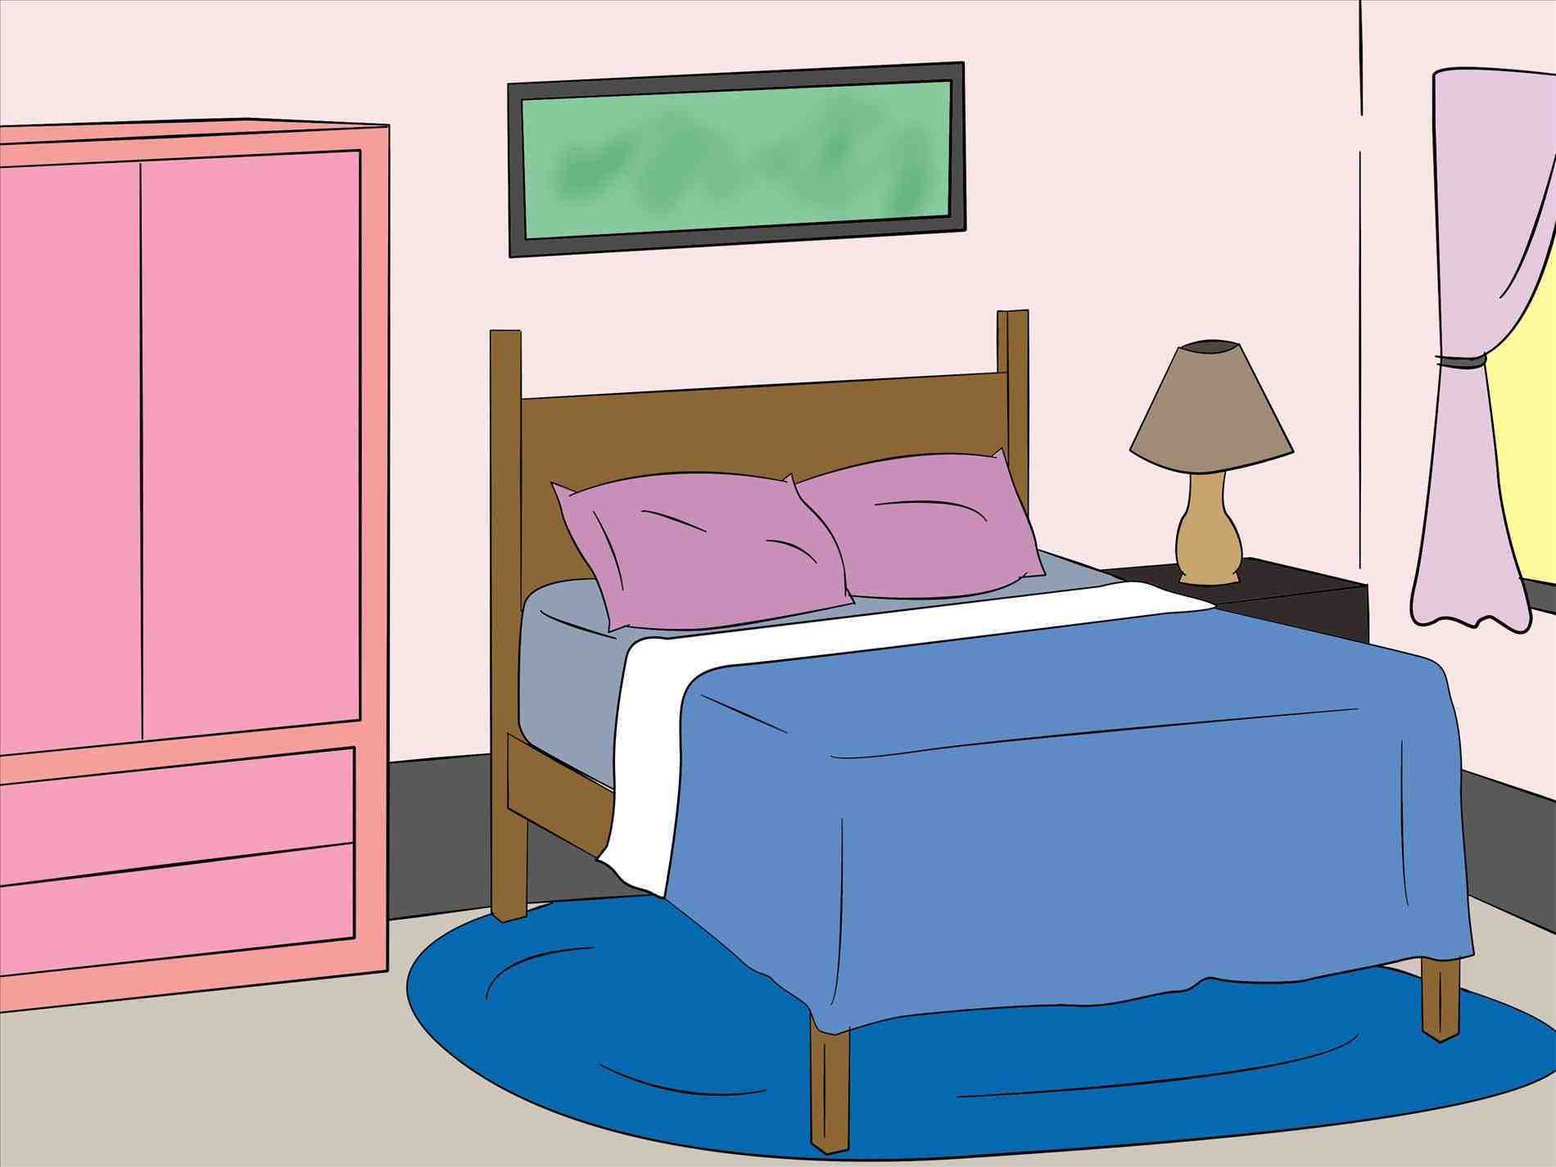
Parts of the House
Bedroom
Dormitorio

Slide 4
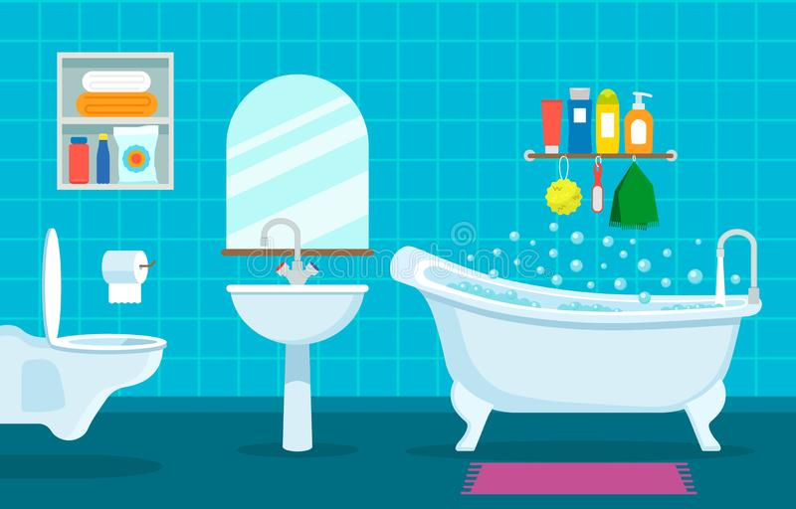
Parts of the House
Bathroom
Baño

Slide 5
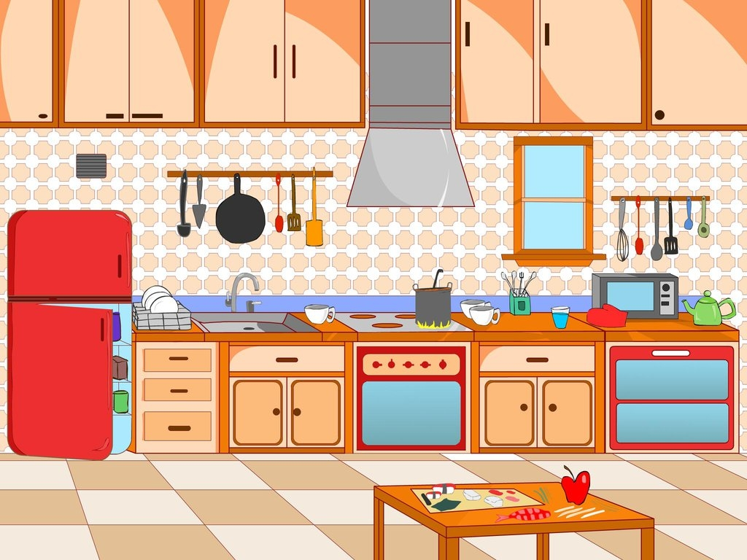
Parts of the House
Kitchen
Cocina

Slide 6
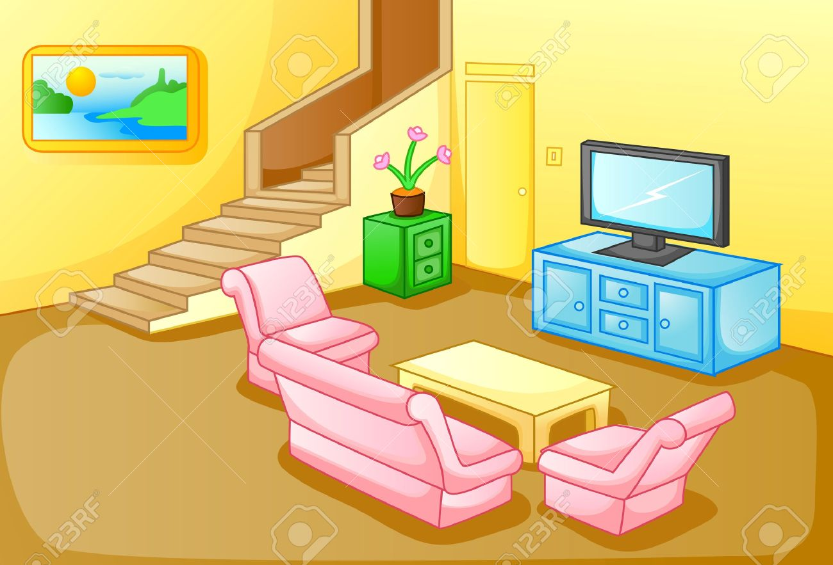
Parts of the House
Living Room
Sala de estar

Slide 7
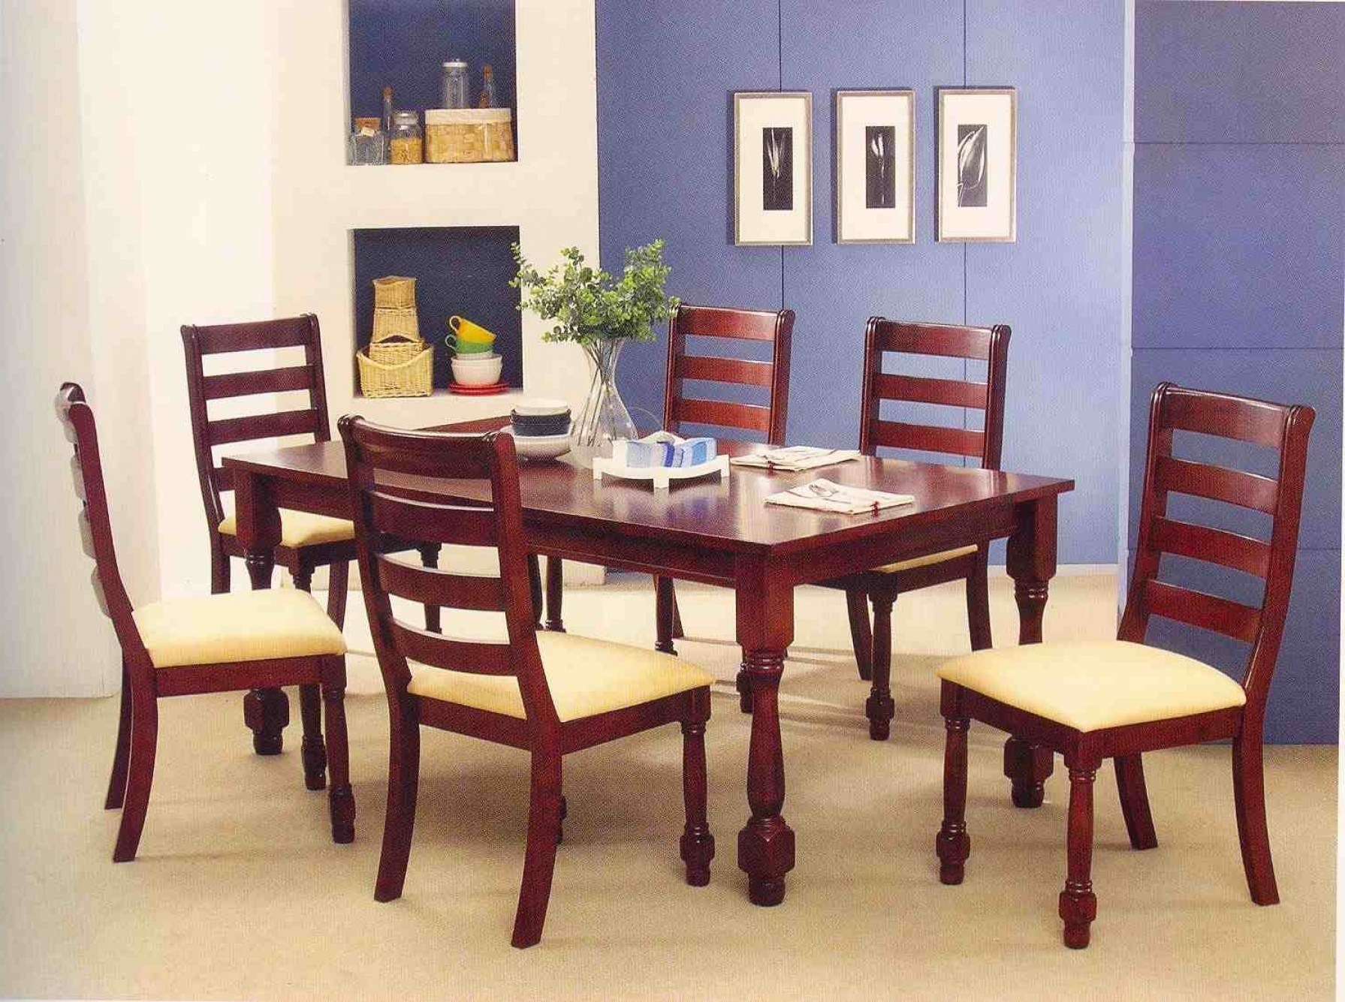
Parts of the House
Dining Room
Comedor

Slide 8
Parts of the House
Garden
Jardín

Slide 9
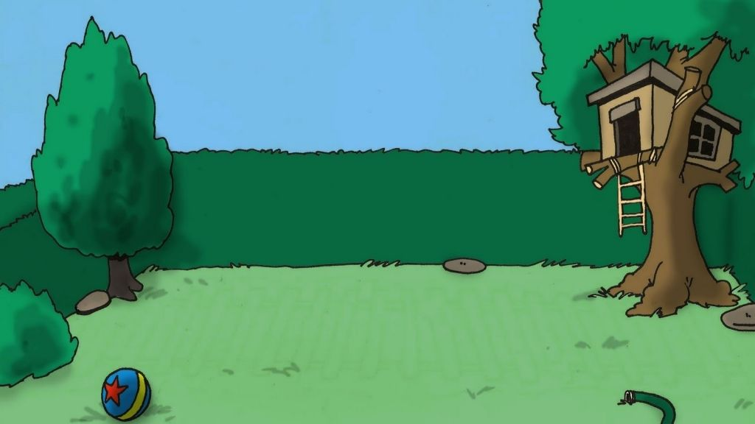
Parts of the House
Yard
Patio

Slide 10
Activity N°1
Write the correct name of the different parts of the house.

Slide 11
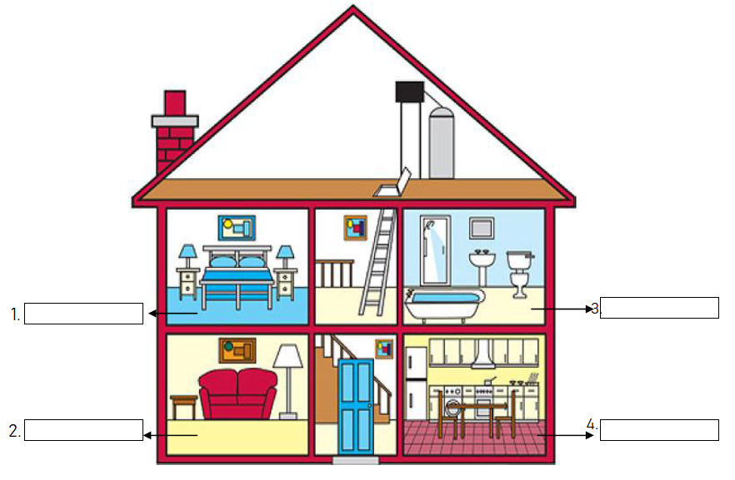

Slide 12
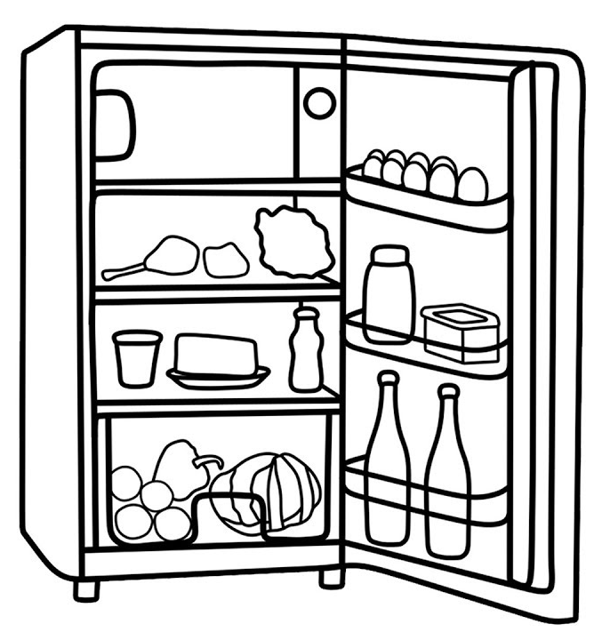
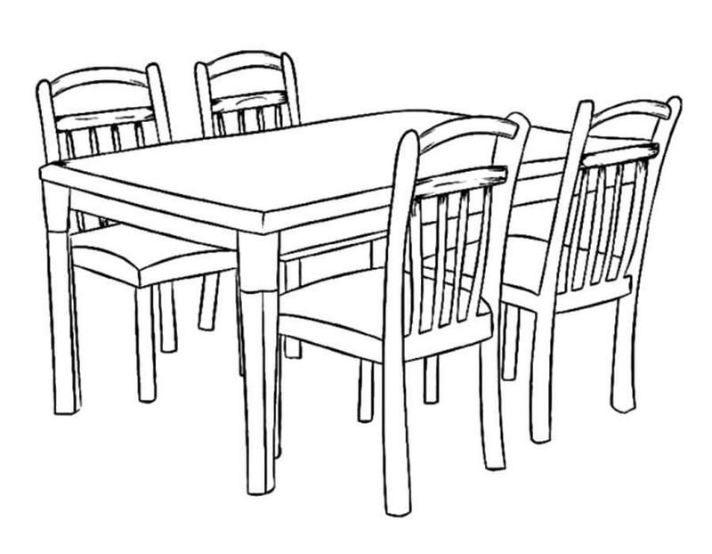
Activity N°2
Write the name of the part of the house in which you could find these objects.
3.
1.
4.
2.

