Slide 1
Unit 1: Food and Health
Centro Educacional San Carlos de Aragón
6° A-B-C / Miss Tamara Sanhueza & Miss Cinzia Bizama
ALLPPT.com _ Free PowerPoint Templates, Diagrams and Charts

Slide 2
June 8th- June 11th
*
Objective: To identify and use different ilnesses.
To identify and use the interrogative form of present continuous.
Ability: Listening, Speaking and Writing.
Attitude: Positive
*Escribir las diapositivas que tengan un asterisco rojo en la orilla
derecha en el cuaderno

Slide 3
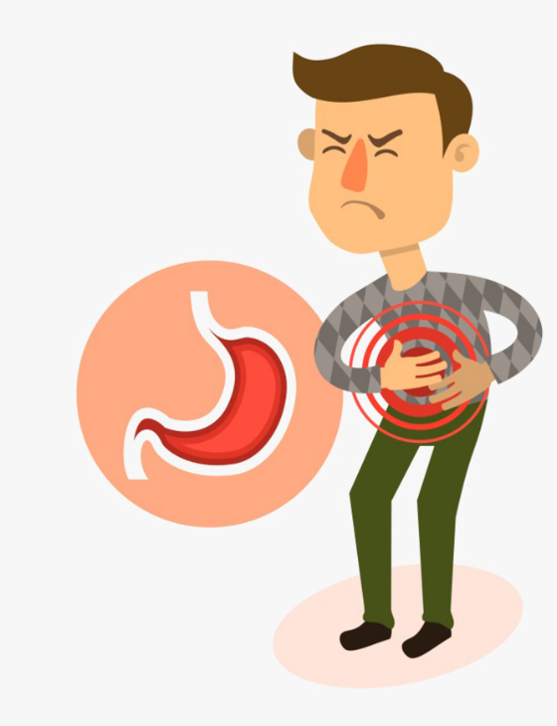
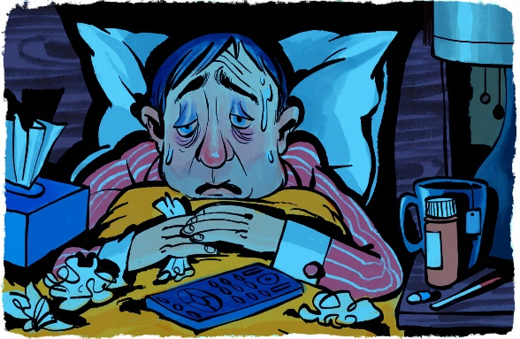
Illnesses
*
Here are some examples of different illnesses:
He has a stomach ache
I have the flu
She has a headache

Slide 4
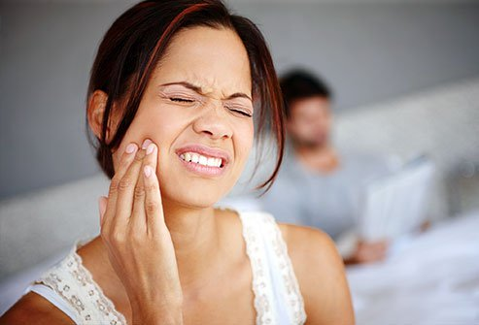
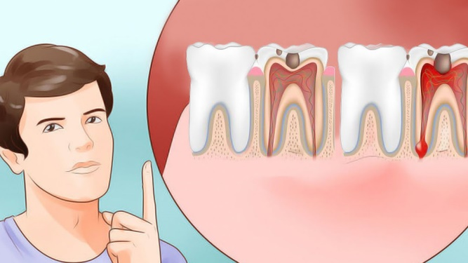
Illnesses
*
You have an earache
She has a toothache

Slide 5
Illnesses
*
She has a sore throat
He has back pain

Slide 6
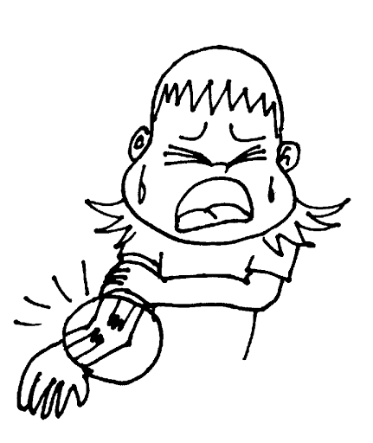
Illnesses
*
He has a broken bone
He has allergies

Slide 7
Present continuous: Interrogative form
*
So far, we have reviewed the affirmative and negative form of present
Continuous. Here, we will learn to make the questions with the present continuous.
For transforming an affirmative sentence to an interrogative form, we have to follow this example:
You are doing the dishes
Are you doing the dishes?
We have to move the subject (I, you, we , They,etc) to the second place,
and bring the verb to be to the first place and we always finish with a
question mark (?)

Slide 8
Here are some examples:
They are watching TV → Are They watching TV?
We are eating Doritos → Are we eating Doritos?
He is sleeping peacefully → Is he sleeping peacefully?
I am going home → Am I going home?
She is reading a book → Is she reading a book?

Slide 9
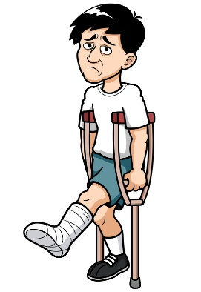
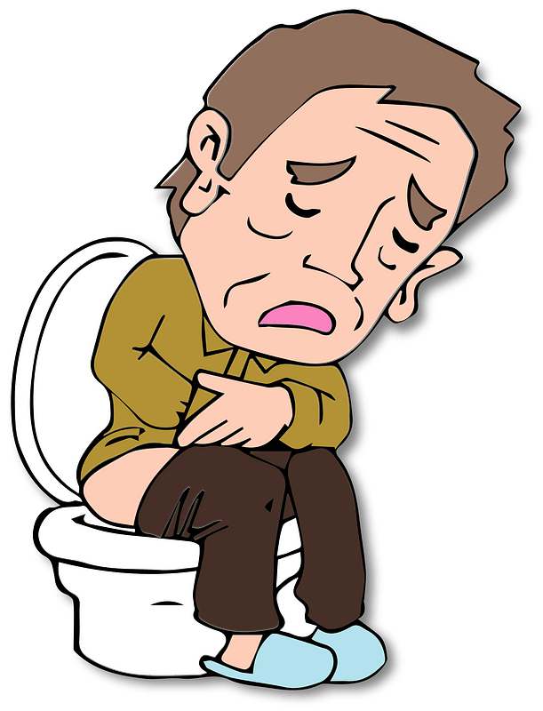
Activity N°1
*
In your notebook, write the name of the following ilnesses:
1.
3.
2.
4.

Slide 10
Activity N°2
*
Transform the following affirmative sentences to their
interrogative form
Example: I am drawing a cactus → Am I drawing a cactus?
He is eating pasta →
She is watching the news →
We are dancing on the table →
They are having a party →
It is eating the couch →

