Slide 1
Unit 1:
My world
Centro Educacional San Carlos de Aragón
5° A-B-C-D
Miss Cinzia Bizama

Slide 2
June 8th - June 11th
*
Objective: To identify and use School subjects
To use Adjectives
Ability: Listening, Speaking and Writing.
Attitude: Positive
*Escribir las diapositivas que tengan un asterisco rojo en la
orilla derecha en el cuaderno
*Repetir cuando se señale en el tutorial

Slide 3
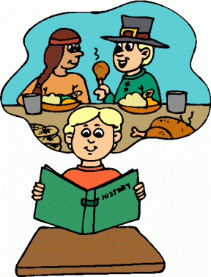
School Subjects
*
At school, we have different subjects/classes:
Spanish
2. Math
3. Science
4. History

Slide 4
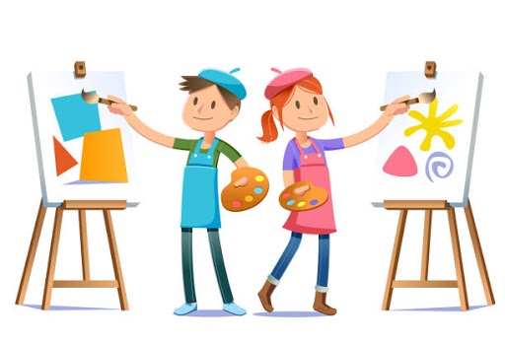
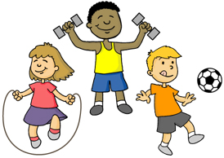
School Subjects
*
5. English
6. P.E (Physical Education)
7. Art
8. Music

Slide 5
Adjectives
*
Adjective are words we use to describe someone or something.
Today we will focus on adjectives to describe people:
Example: This girl is very pretty
We can describe someone physically
Beautiful (hermoso/a)
Handsome (atractivo)
Tall (alto/a)
Short (bajo/a)
Thin (delgado/a)
Stout (robusto/a)
Or we can describe them
Psychologically
Kind (amable)
Smart (inteligente)
Selfish (egoísta)
Patient (paciente)
Funny (chistoso/a)
Quiet (callado/a)

Slide 6
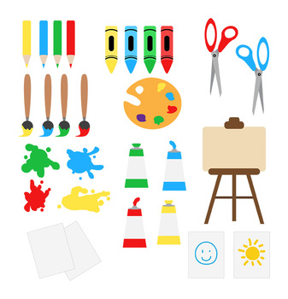
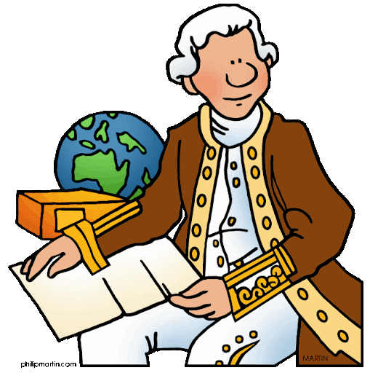
Activity N°1
*
Write the name of the class according to the supplies that you can
see:
3.
1.
2.
4.

Slide 7
Activity N°2
*
Make a drawing of your best friend, write their name and use 5 adjectives to describe him/her
Ejemplo (Sólo un ejemplo para seguir como modelo):
Si hay un adjetivo que quieras ocupar que no esté en este ppt, puedes buscarlo en el diccionario.
She is …
Funny
Beautiful
Smart
Short
Patient
María José

