Slide 1
Unit 1: How do you feel?
Centro Educacional San Carlos de Aragón- 4°A-B-C-D
Miss Tamara Sanhueza & Miss Cinzia Bizama.

Slide 2
May 4th – May 8th
*
Objective: To identify and use expressions related to health and sickness.
Ability: Listening, Speaking and Writing.
Attitude: Curious
*Escribir las diapositivas que tengan un asterisco rojo en el cuaderno
En donde hayan imágenes, el/la alumno/a sólo dibujar un solo dibujo alusivo al concepto.
Hacer click en el parlante al lado de la expresión para escuchar la pronunciación.

Slide 3
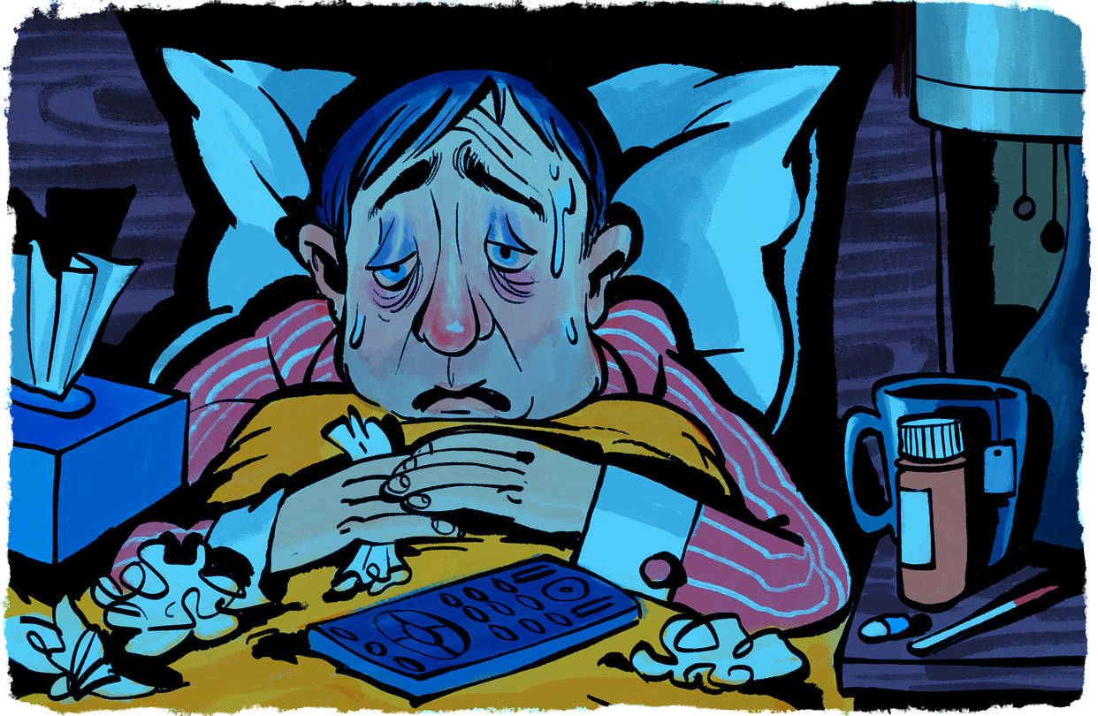
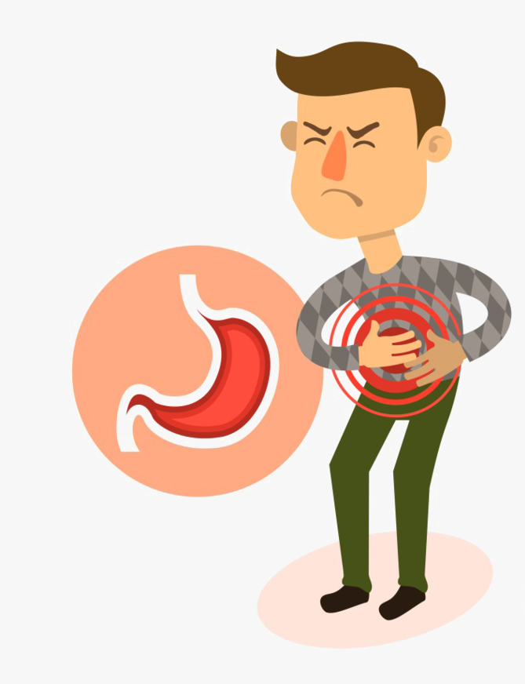
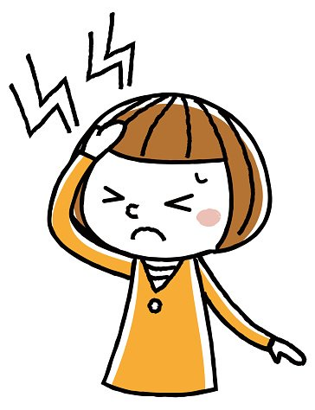
Diseases and Illness
*
I have the flu
He has a stomach ache
I have a headache

Slide 4
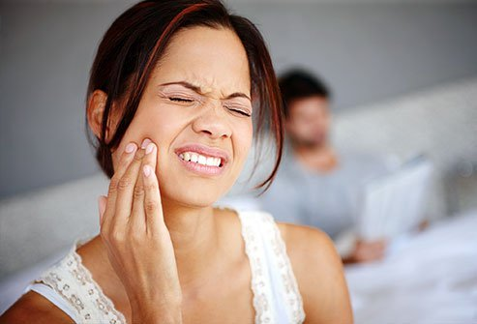
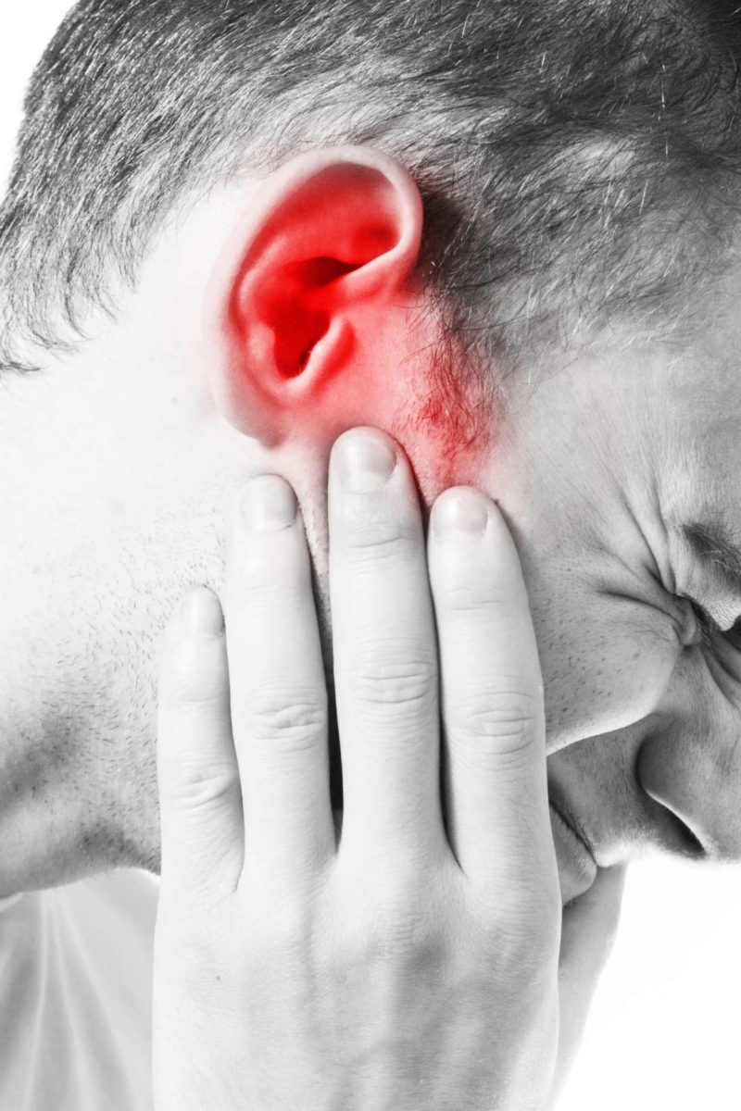
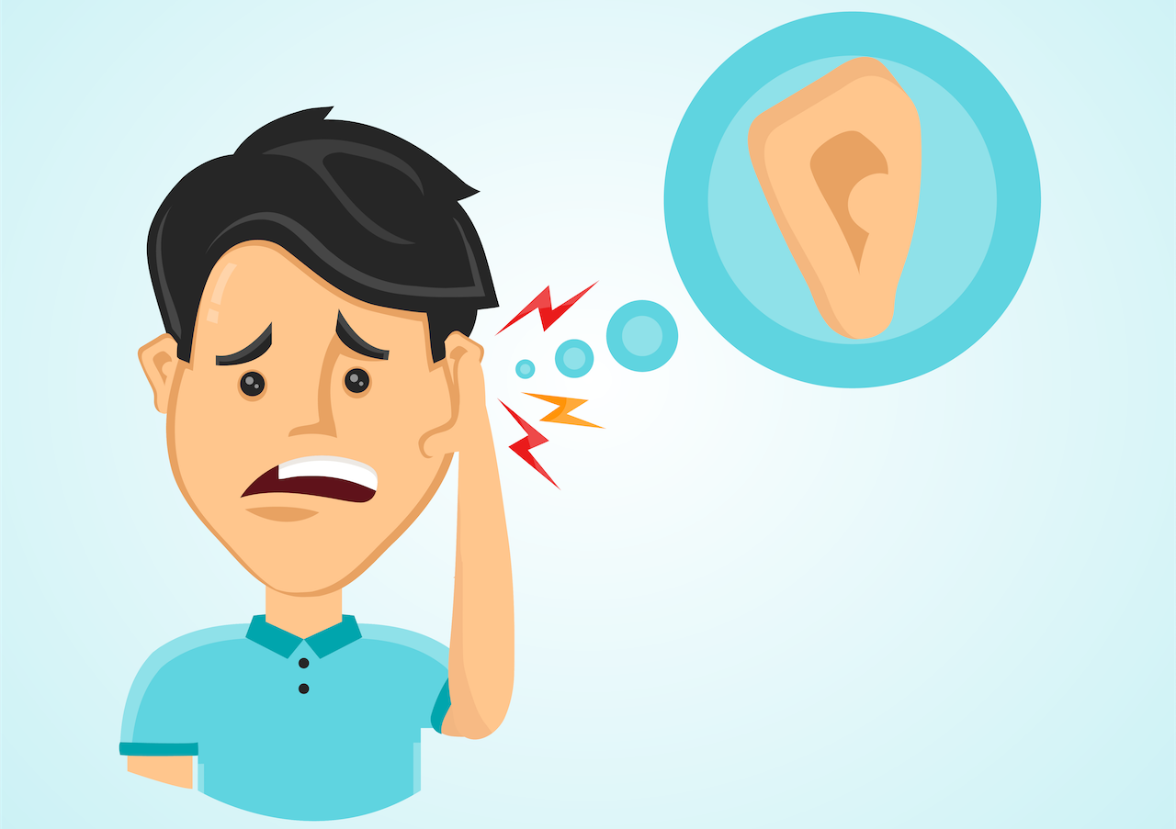
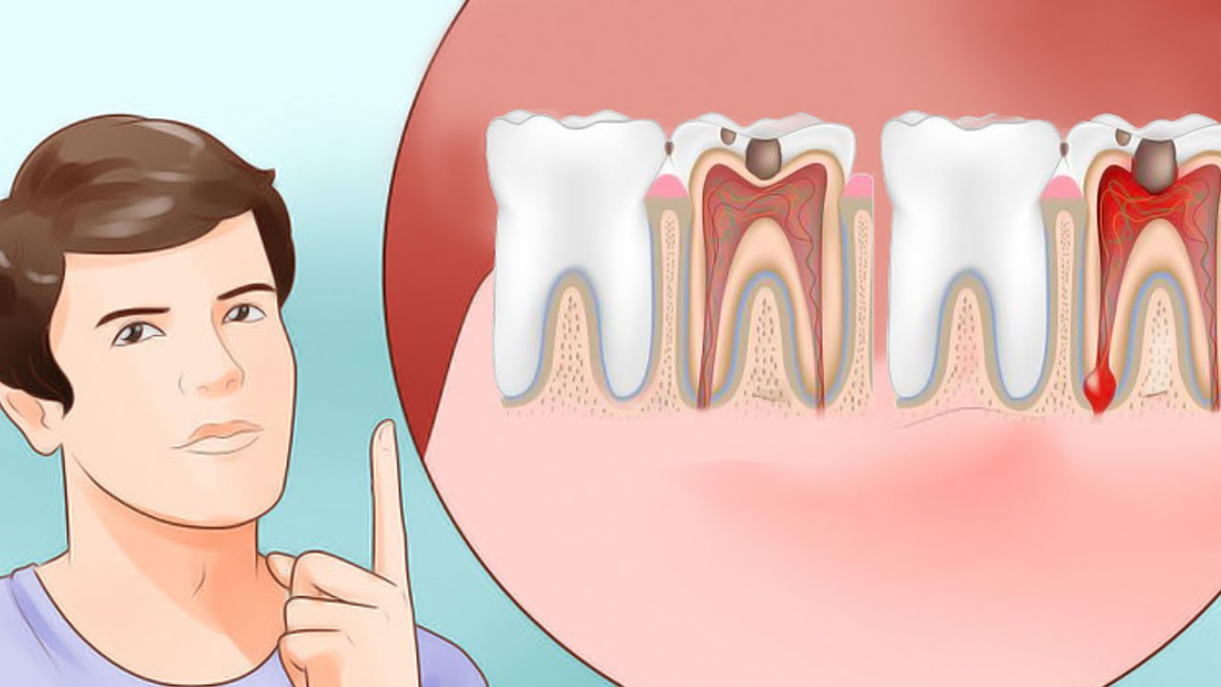
Diseases and Illness
*
You have an earache
She has a toothache

Slide 5
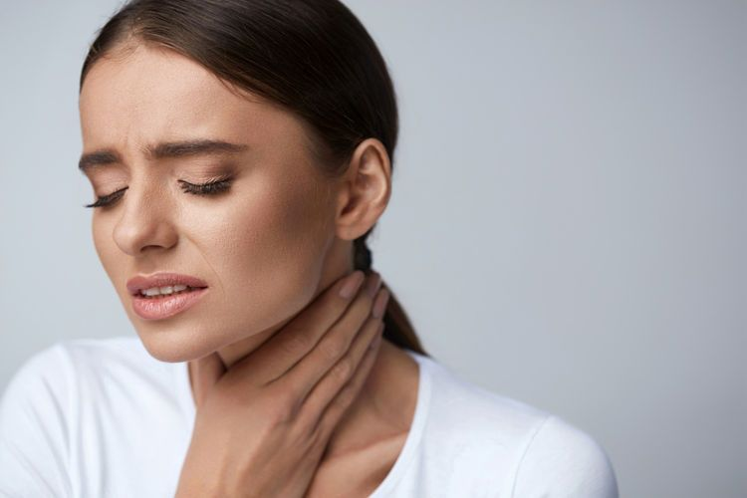
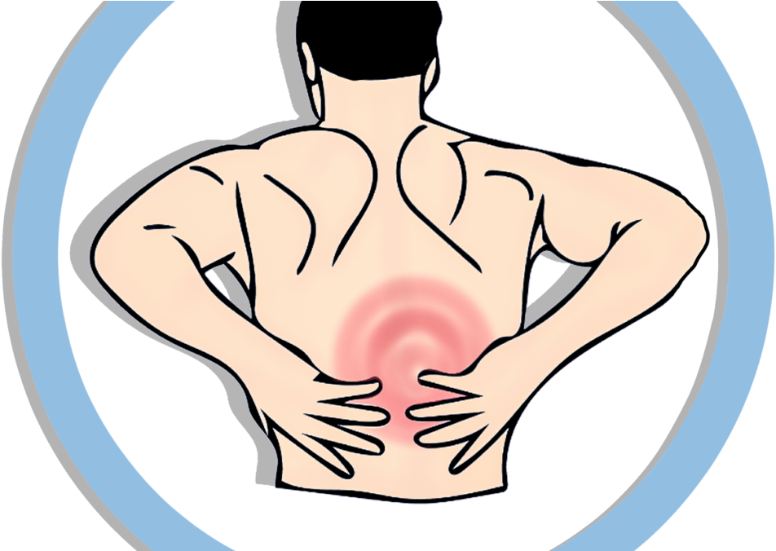
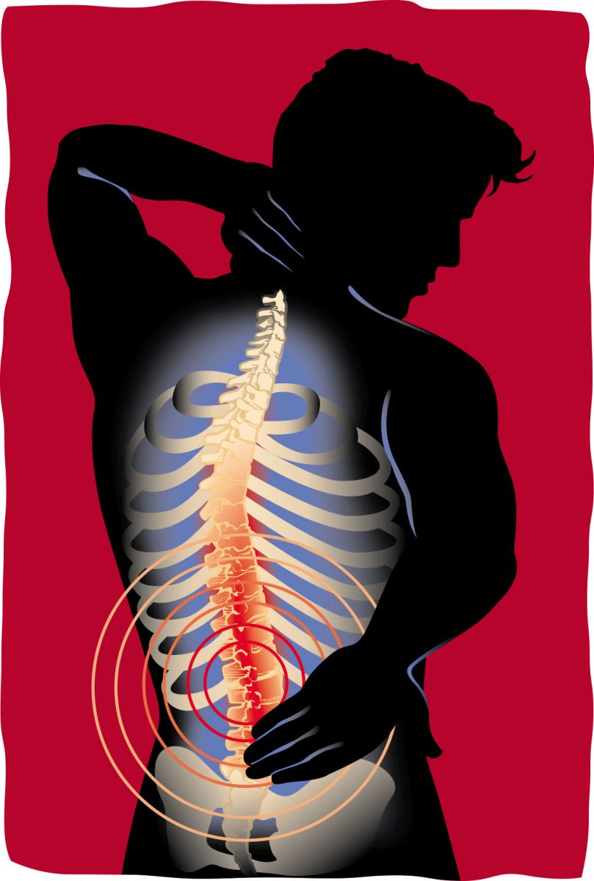
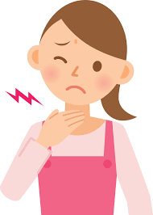
Diseases and Illness
*
She has a sore throat
He has back pain

Slide 6
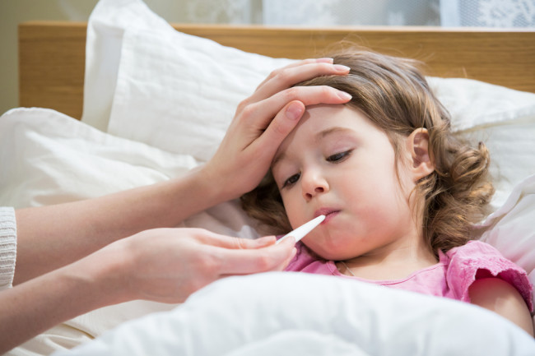
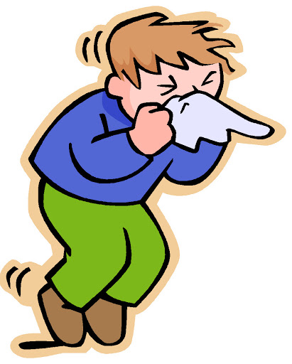
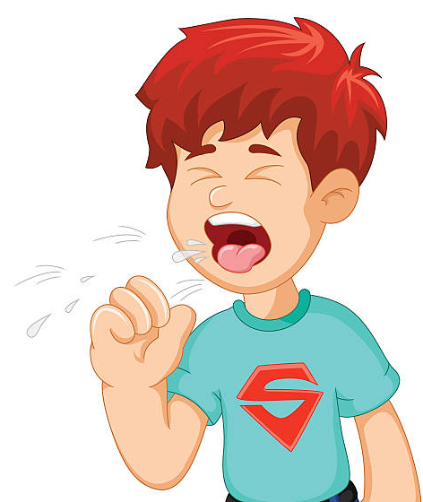
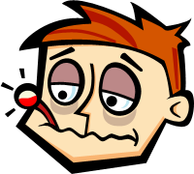
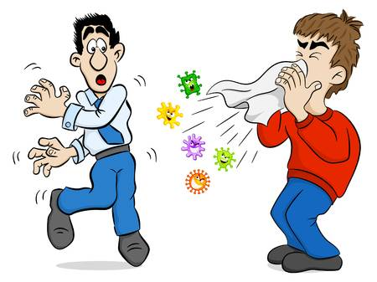
Symptoms
*
A fever
A cough
A sneeze

Slide 7
Use of have and has
*
We use have or has to express belonging of something.
For example: I have a fever (yo tengo fiebre)
I have the flu (yo tengo gripe
But we use have or had depending on the person:
For example: I have a sore throat (yo tengo dolor de garganta)
He has back pain ( Él tiene dolor de espalda)
He have back pain

Slide 8
Use of have and has
*
Here’s an example for every person:
I have a fever
You have a fever
He has a fever
She has a fever
We have a fever
They have a fever
It has a fever
I
You
We
They
have
He
She
It
has

Slide 9
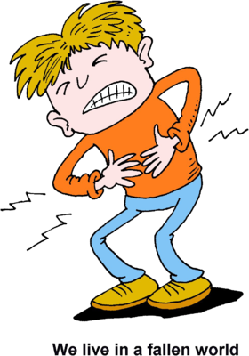
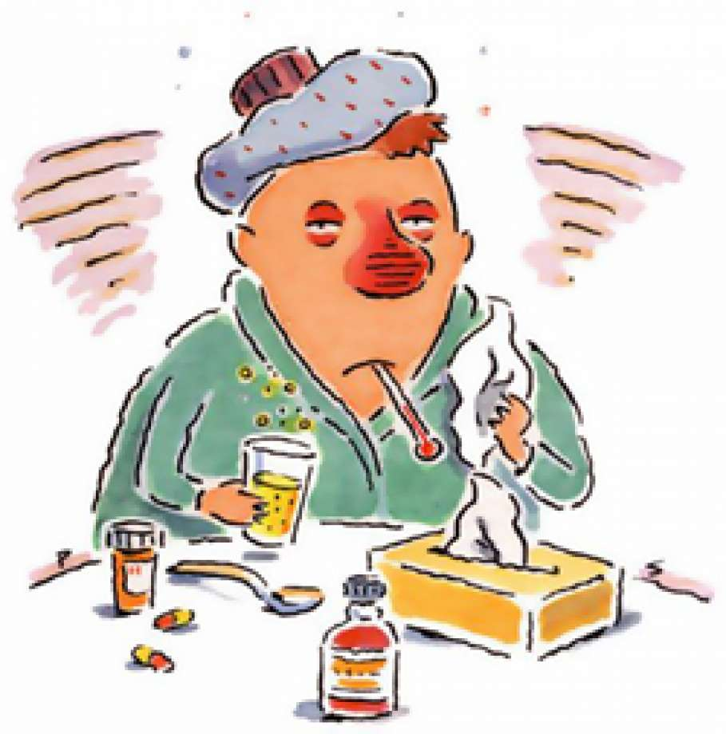
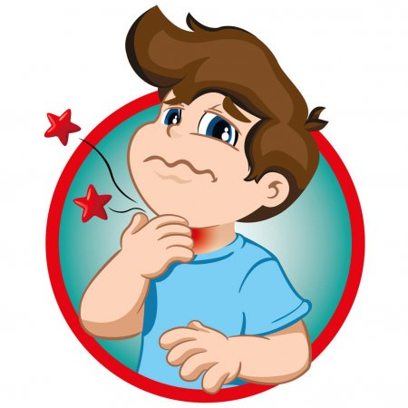
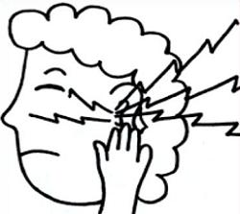
Activity N°1
*
Write in your notebook the name of the following ilnesses:
1.
3.
5.
2.
4.

Slide 10
Activity N°2
*
Complete using have or has
He _____ a toothache.
I ____ a sore throat.
She ____ a fever.
It ______ the flu.
We _____ an earache.
They ____ a stomach ache.

Slide 11
Videos complementarios
https://www.youtube.com/watch?v=5xZYFPJ0fps
https://www.youtube.com/watch?v=K1QBp79dvR8

